Slide 1

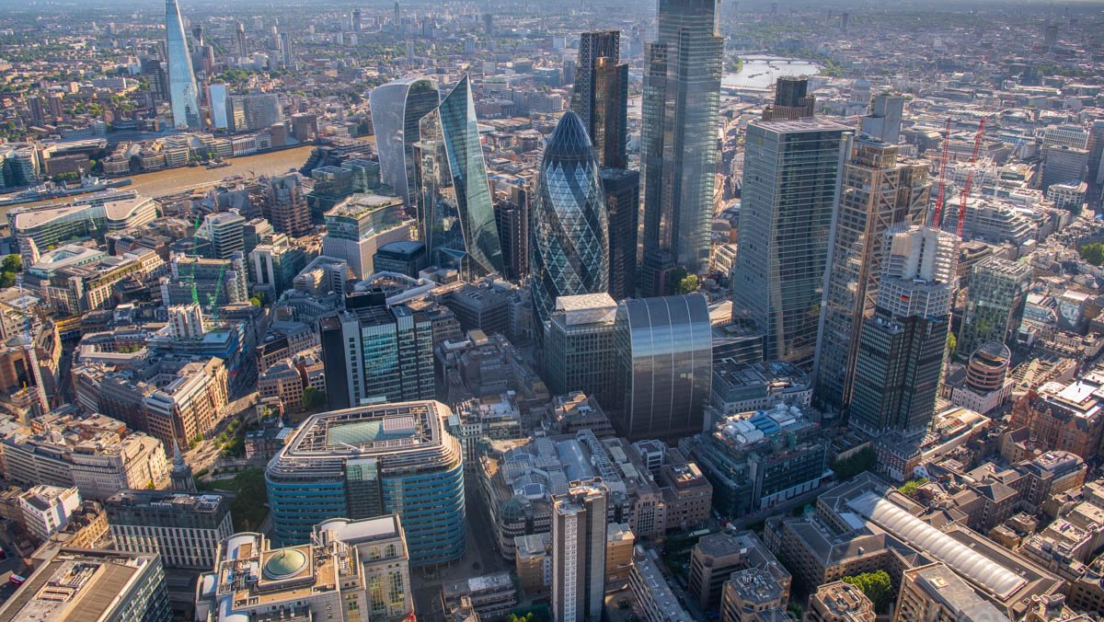



LEAF CLASSIFICATION USING MOBILENETV2 TRANSFER LEARNING
Telkom University - NamaTimnyaApa

Slide 2



Intro
Abstract, Background, Identification, Scope of Problem, and Purpose
Methodology
MobileNetV2 algorithm.
Implementation
Training the model
Analysis
Evaluate the result.
Conclusion
Give conclusion about BERT performance.

Slide 3



Intro
Methodology
Implementation
Analysis
Introduction
Conclusion
Got an 440 image, we want to classify image using MobileNet Version 2 Algorithm.

Slide 4
Intro
Abstract, Background, Identification, Scope of Problem, and Purpose
Methodology
MobileNetV2 algorithm.
Implementation
Training the model
Analysis
Evaluate the result.
Conclusion
Give conclusion about BERT performance.

Slide 5
Intro
Methodology
Implementation
Analysis
Why MobileNet V2 ?
Conclusion
Have fast performance
No need GPU for Transfer Learning
ImageNet Pretrained Model Availability
Release in 2017

Slide 6
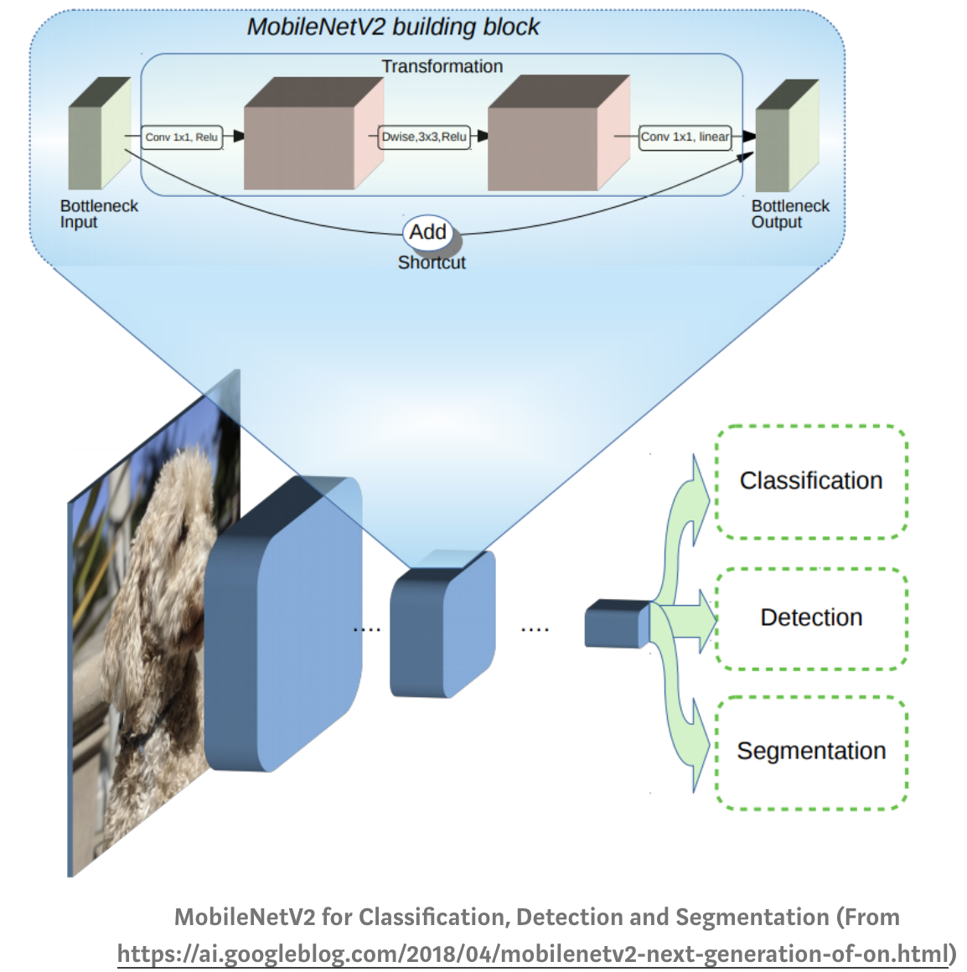

MobileNetV2 Architecture

Slide 7
Intro
Abstract, Background, Identification, Scope of Problem, and Purpose
Methodology
MobileNetV2 algorithm.
Implementation
Training the model
Analysis
Evaluate the result.
Conclusion
Give conclusion about BERT performance.

Slide 8






MobileNetV2 algorithm
Intro
Methodology
Implementation
Analysis
Preprocessing
Training
Evaluate
Dataset
Model
Evaluate
Resource Data
Using Data Training
Result
Evaluate
Model
Dataset is an image from leaf
There are 11 class all of data set which is every class have a 40 data as image. There for, total number of dataset is 445.
Data Splitting
Resize
Normalization
Setup hyperparameter for training algorithm
Predict data testing using a model, and evaluate the predict result.
the result for training with MobileNet V2 algorithm is model.

Slide 9
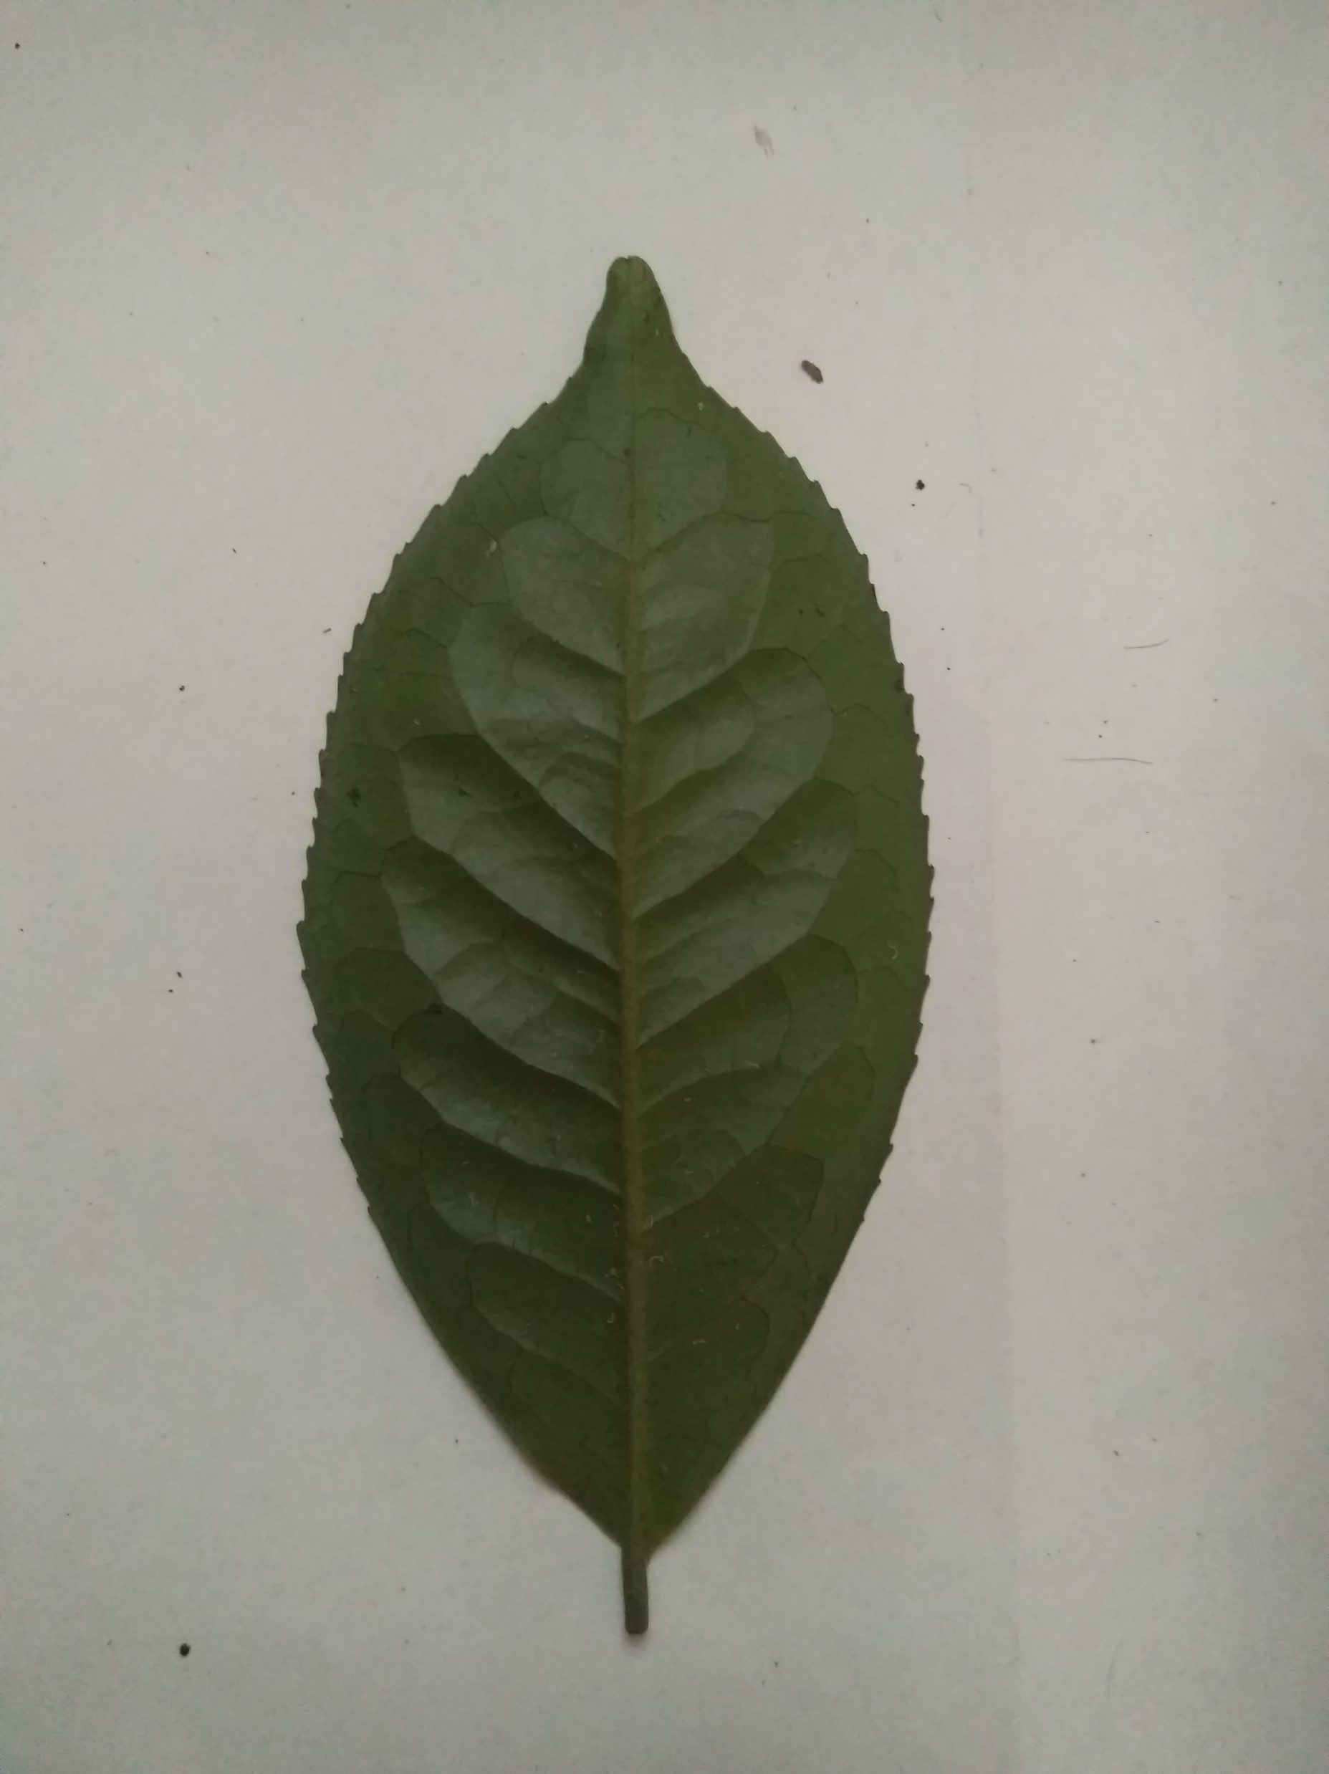
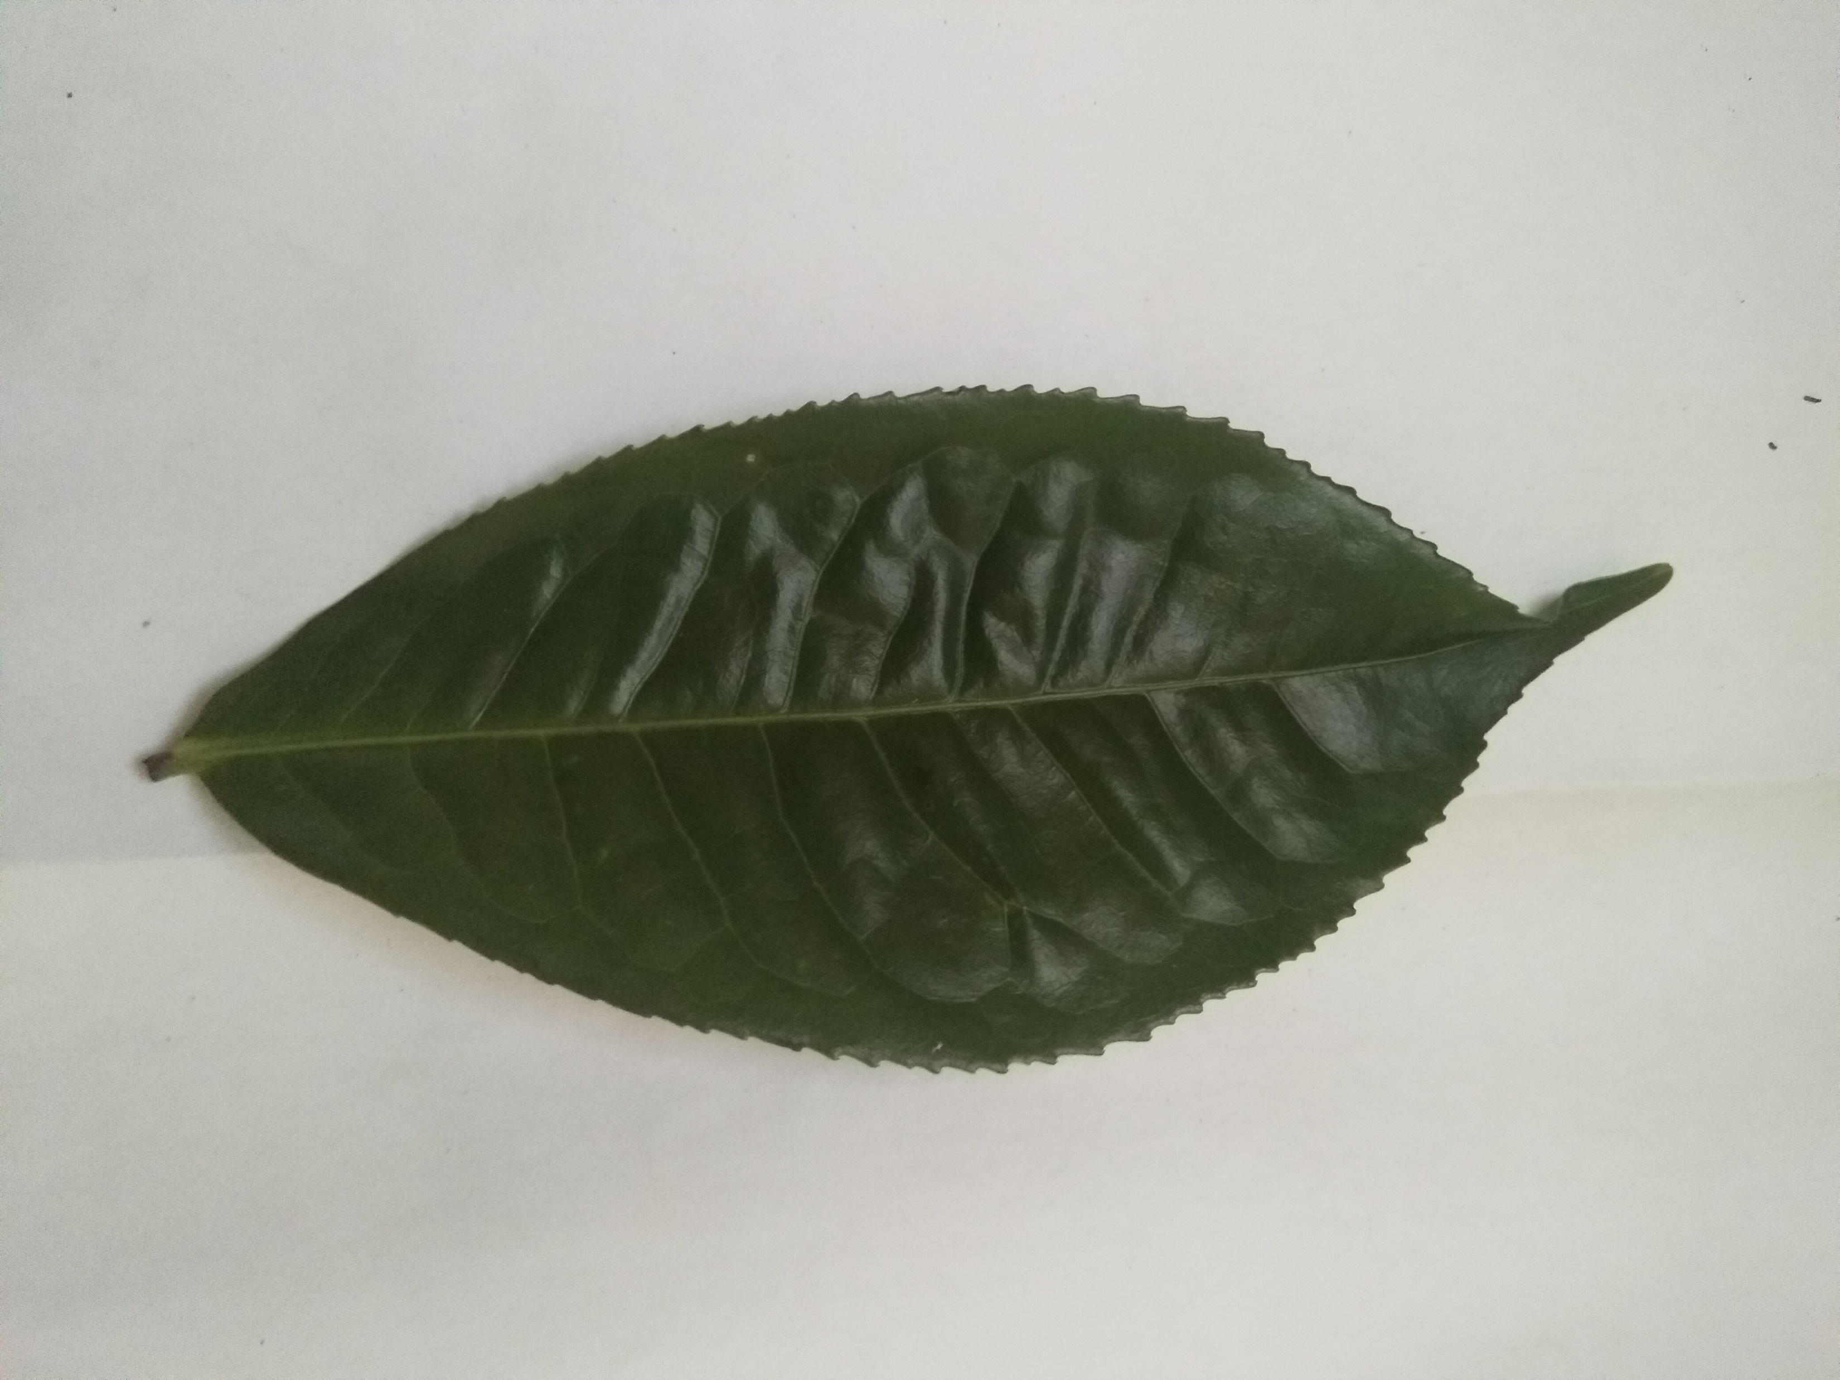
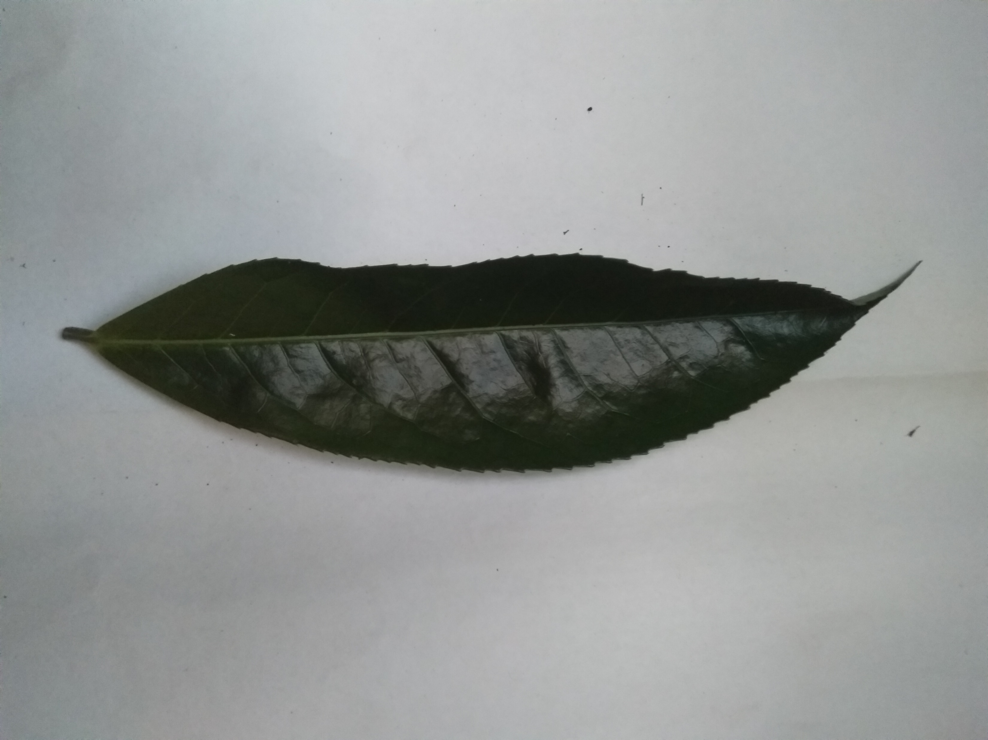
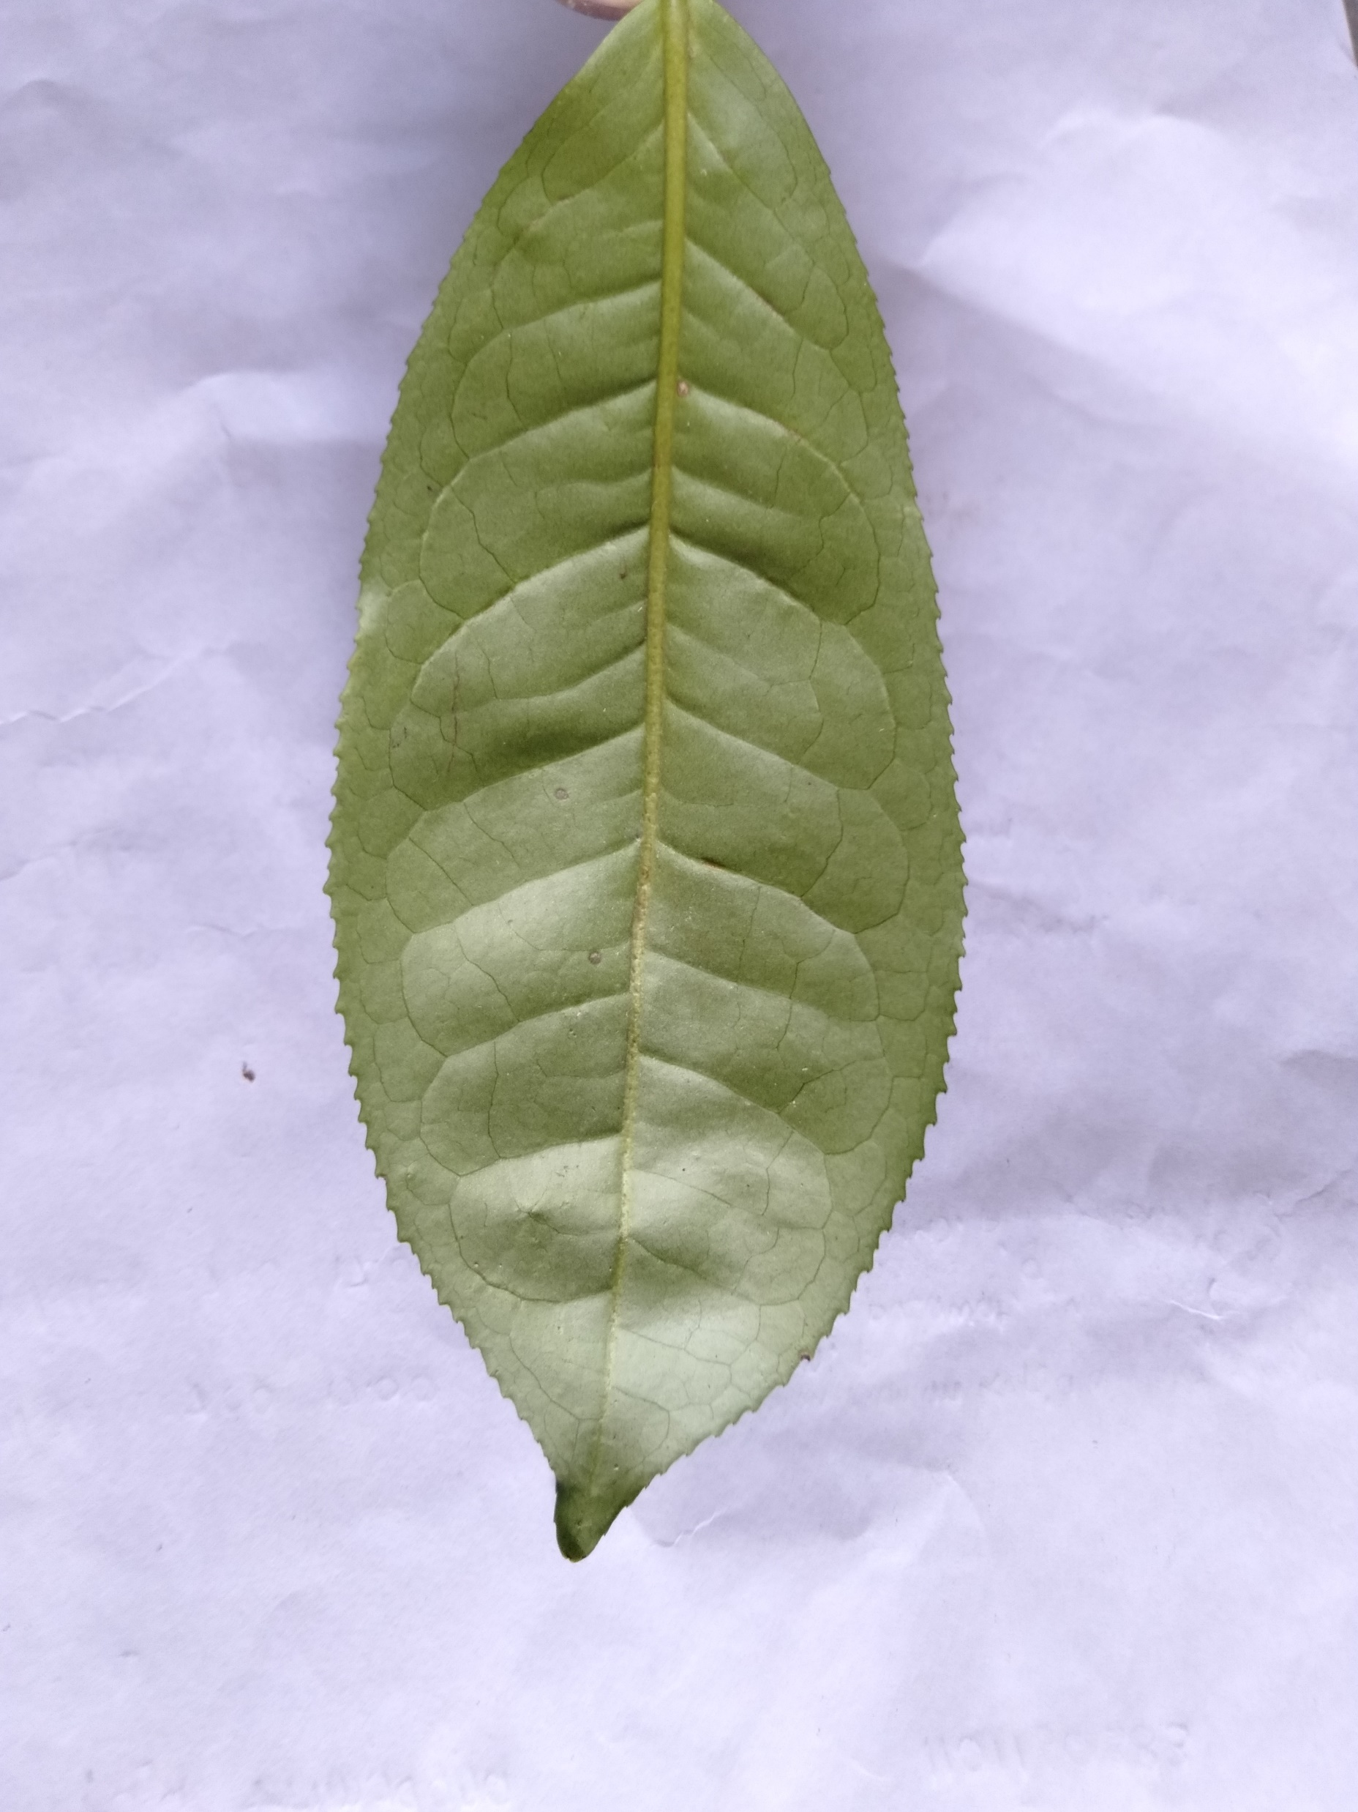
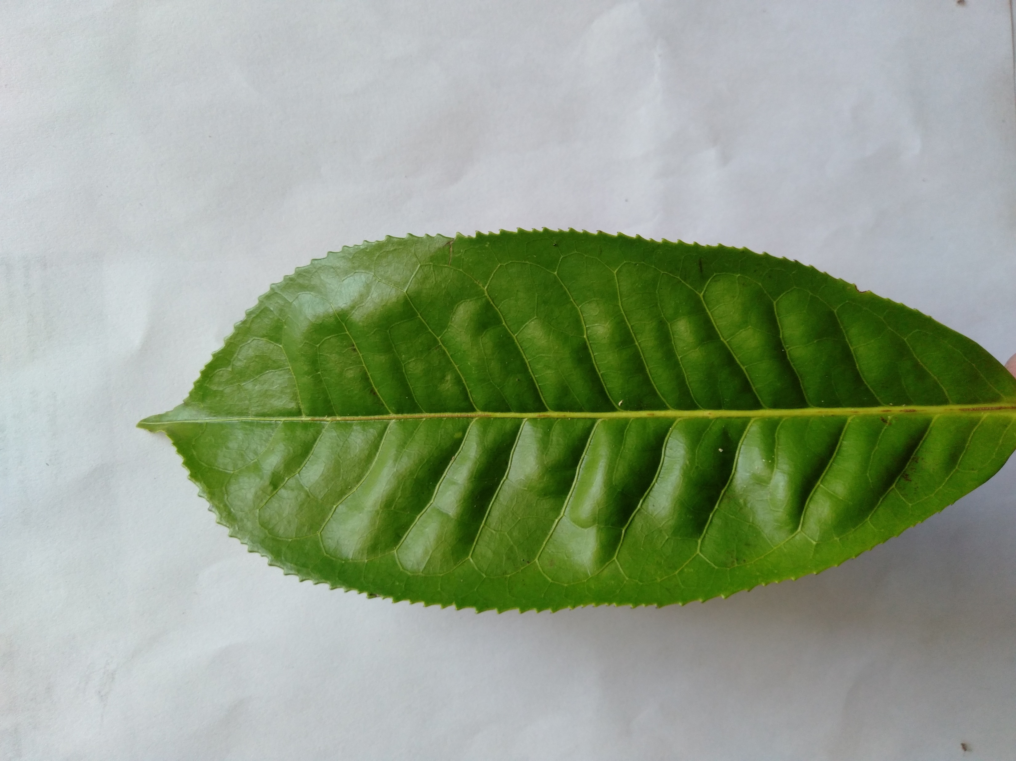
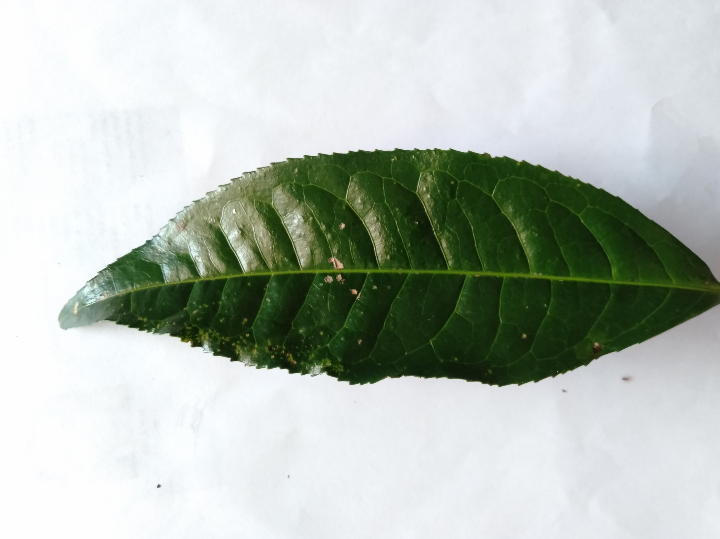
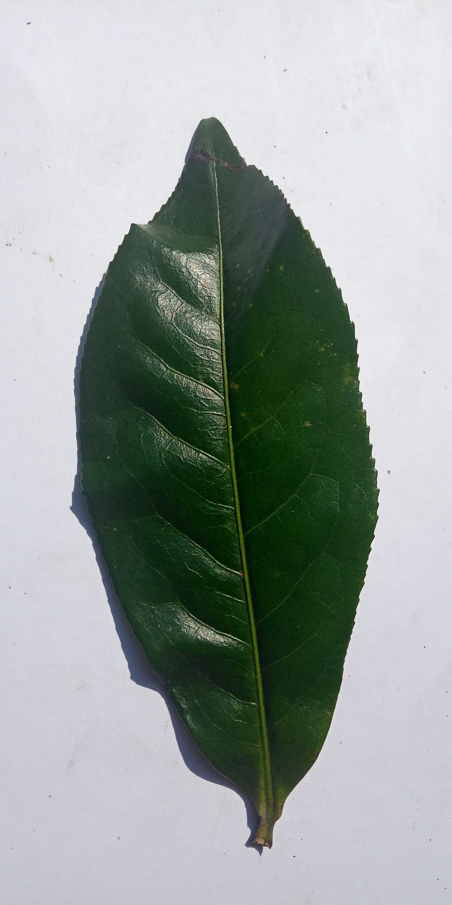
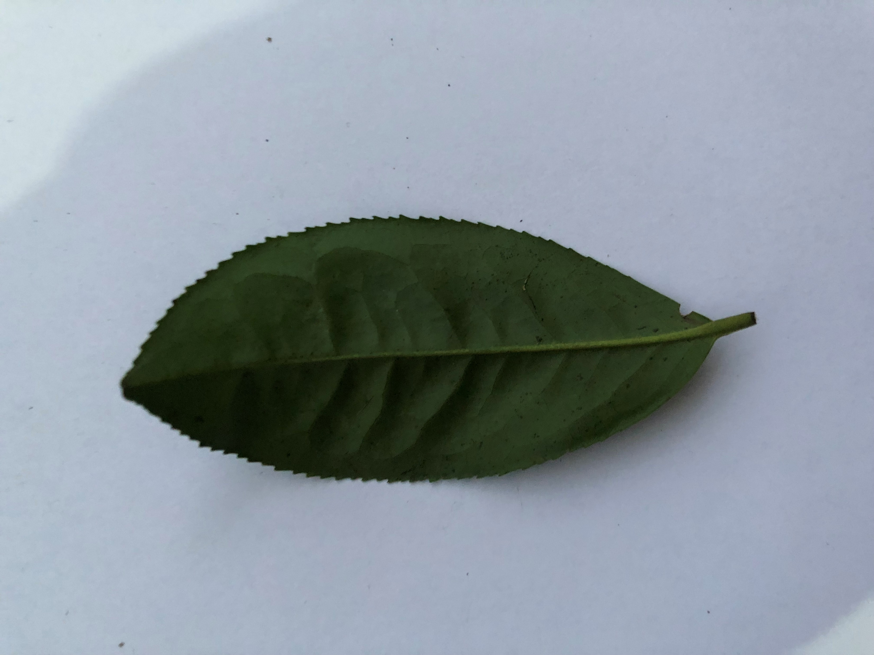
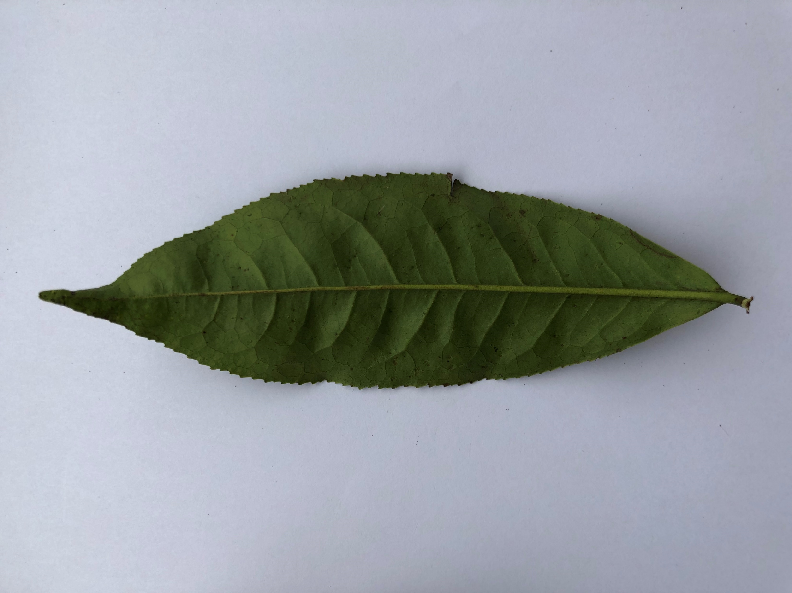
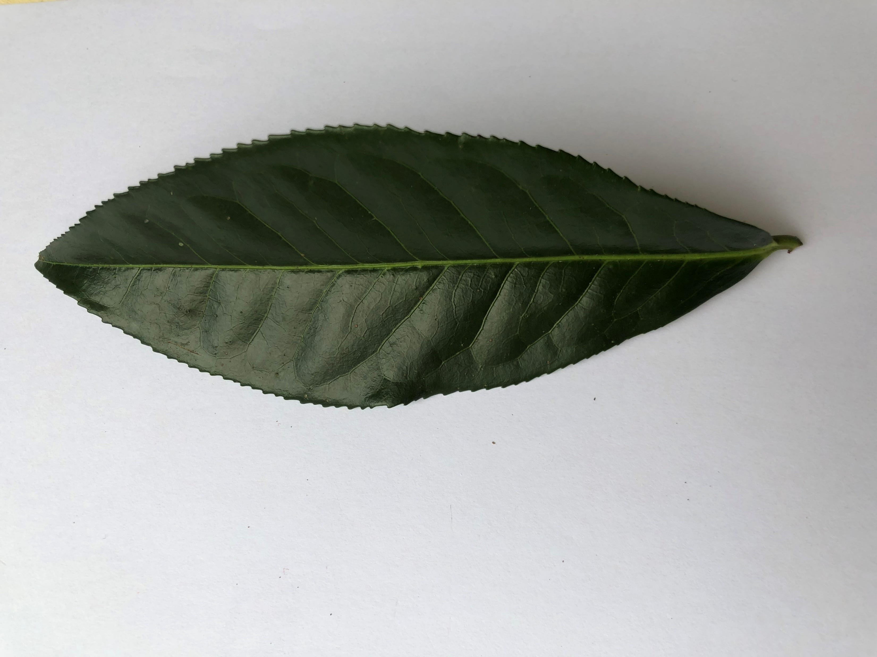
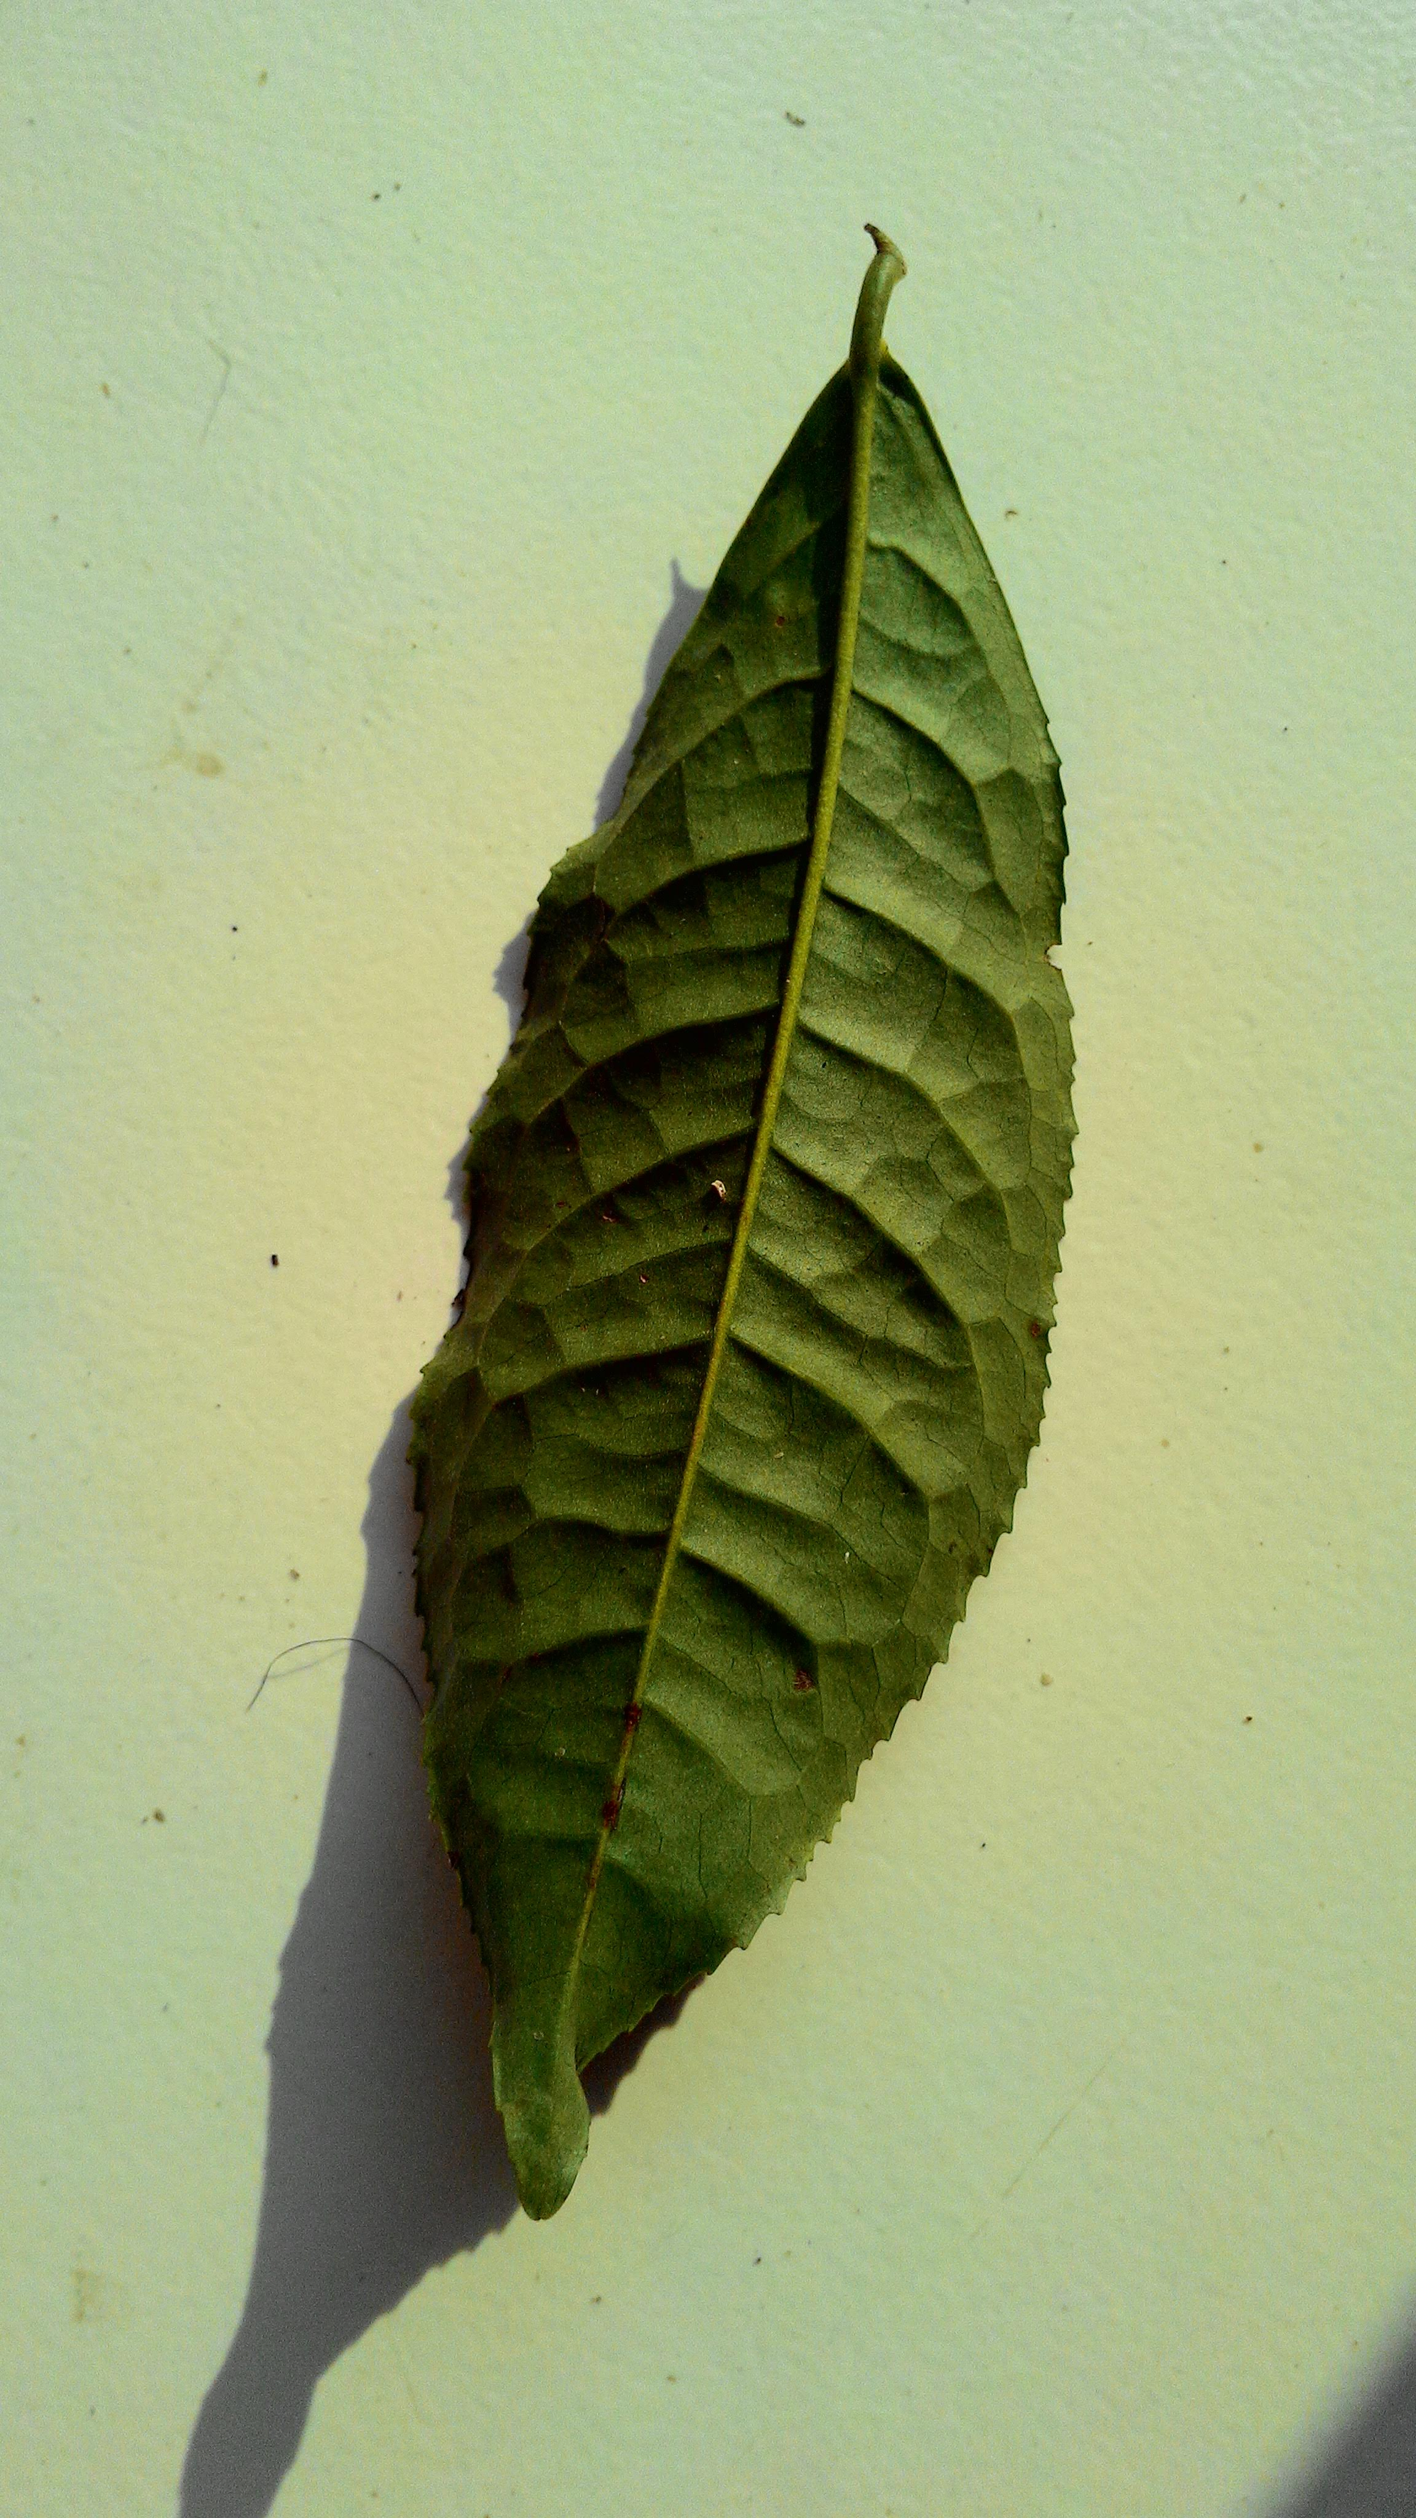
Gambar 3
Dataset
Gambar 1
Gambar 2
Gambar 3
Gambar 4
Gambar 5
Gambar 6
Gambar 7
Gambar 8
Gambar 9
Gambar 10
Gambar 11

Slide 10
Preprocessing
Dataset split
Total Data: 445
0.3 Validation
312 Test
133 Validation
Resize
224x224
Normalization
0 to 1

Slide 11
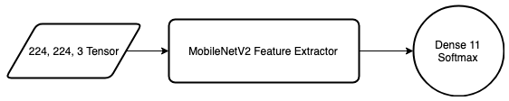
Model Architecture

Slide 12
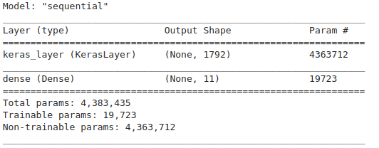
Model Architecture

Slide 13
Hyperparameter
MobileNetV2
Depth Multiplier: 1.40
Input Shape: 224, 244, 3
Optimizer: Adam
Batch Size: 8
Epoch: 10

Slide 14
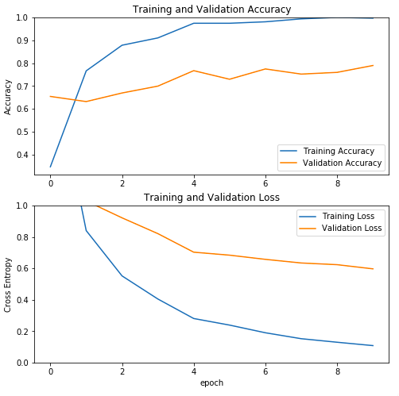
Training

Slide 15
Evaluation
Val Loss: 0.6275522199096735
Val Acc: 0.7876106
Failed: 20 / 133 (Top 1)
Average mAP: 0.89

Slide 16
Intro
Abstract, Background, Identification, Scope of Problem, and Purpose
Methodology
MobileNetV2 algorithm.
Implementation
Training the model
Analysis
Evaluate the result.
Conclusion
Give conclusion about MobileNet Version 2 performance.

Slide 17

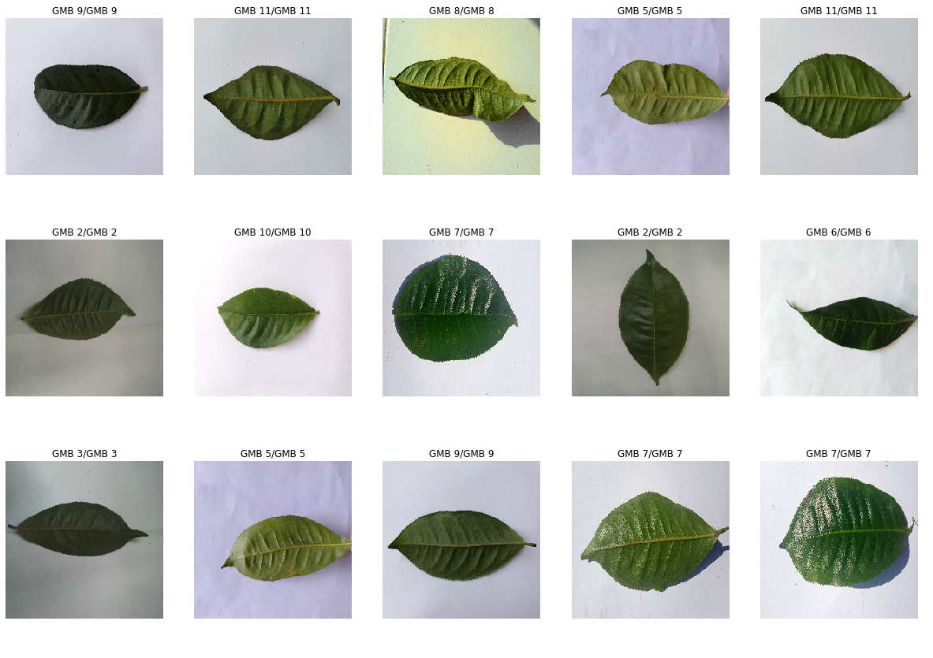

Slide 18
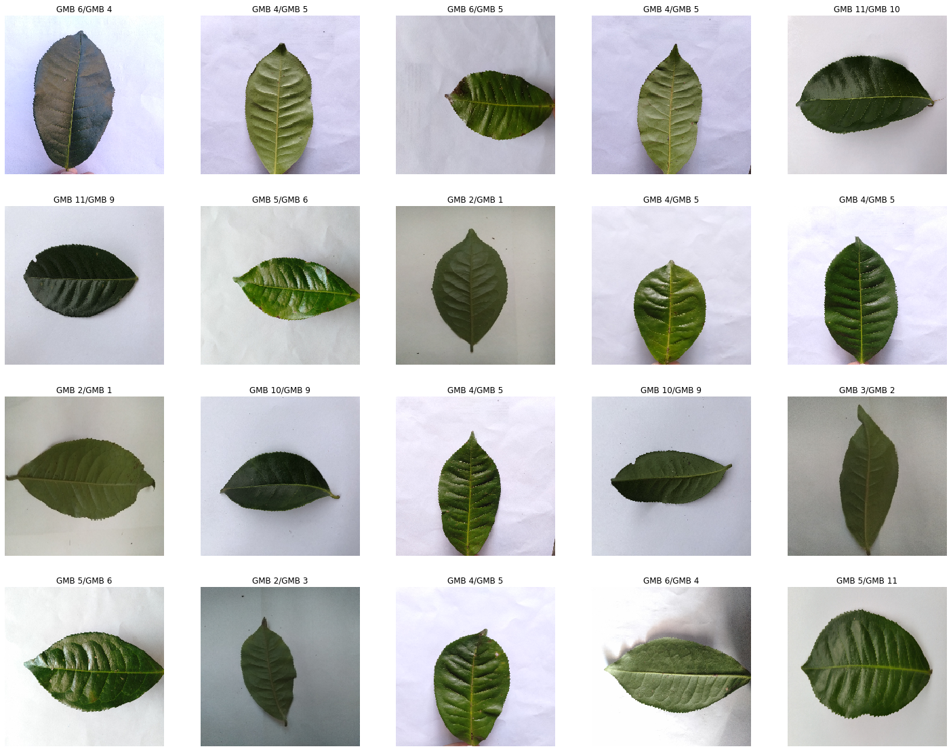

Slide 19
Intro
Abstract, Background, Identification, Scope of Problem, and Purpose
Methodology
MobileNetV2 algorithm.
Implementation
Training the model
Analysis
Evaluate the result.
Conclusion
Give conclusion about MobileNet Version 2 performance.

Slide 20


Intro
Methodology
Implementation
Analysis
Conclusion
Conclusion
The result for classifying each image isn’t good enough if we have finger on the image
MobileNetV2 transfer learning is qualified to classify leaf

Slide 21

Thank You

